Slide 1
UNICORN COMPANY ANALYSIS
BY OLADAPO PRECIOUS

Slide 2
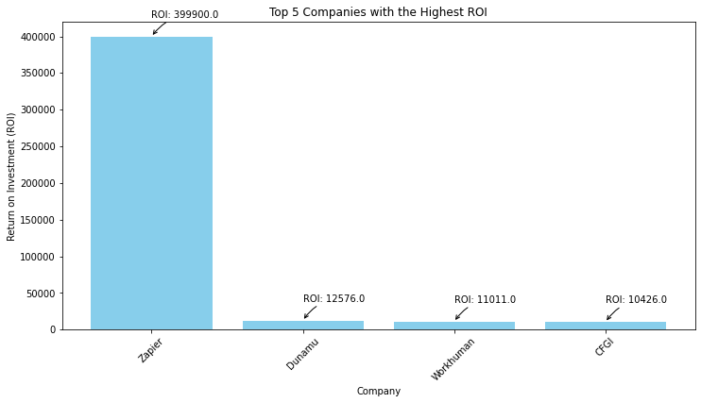
TOP 5 COMPANIES WITH THE HIGHEST ROI AFTER OTTO BOCK HEALTHCARE

Slide 3
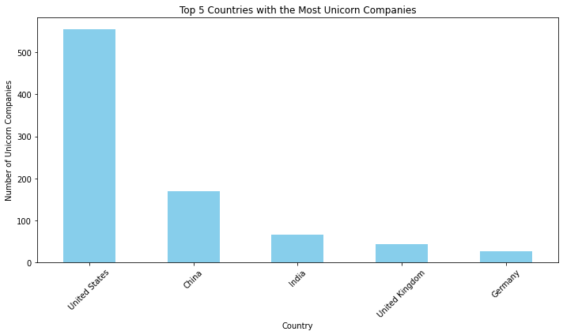
TOP 5 COMPANIES WITH THE MOST UNICORN

Slide 4
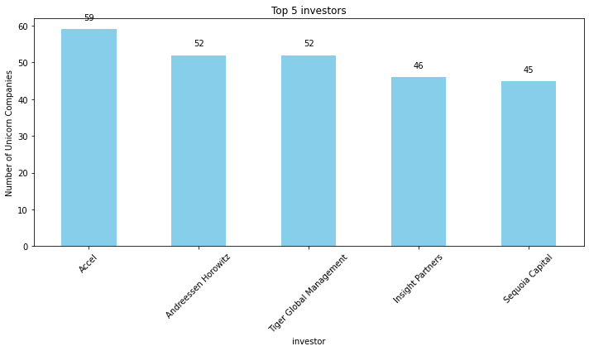
TOP 5 INVESTORS

Slide 5
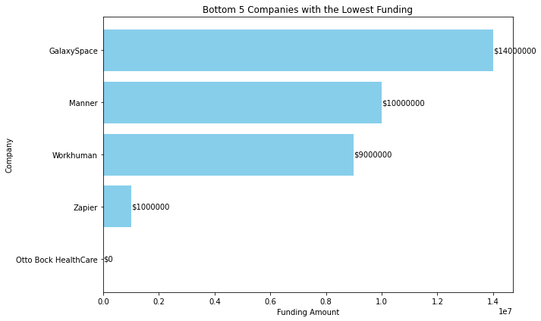
BOTTOM 5 COMPANIES WITH THE LOWEST FUNDING

Slide 6
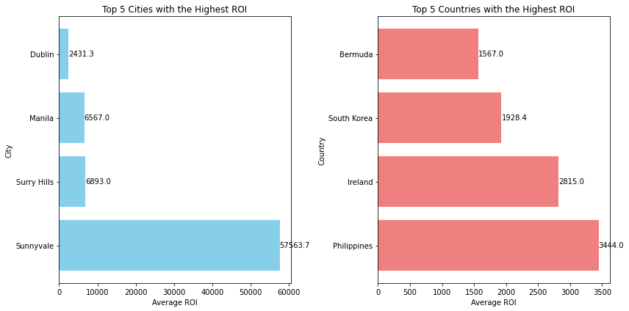
TOP 5 CITIES AND COUNTRIES WITH THE HIGHEST ROI

Slide 7
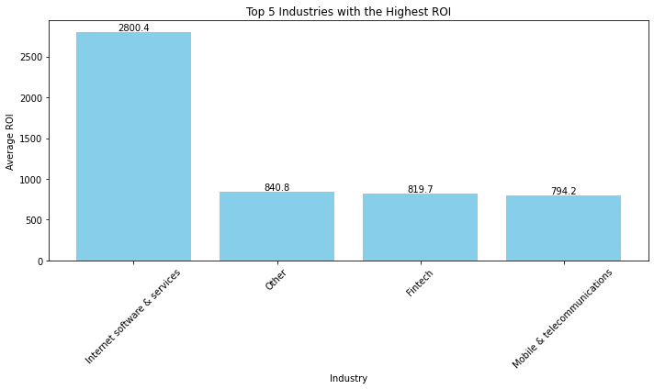
TOP 5 INDUSTRIES WITH THE HIGHEST ROI

Slide 8
THE INDUSTRY WITH THE HIGEST VALUE
Fintech 216
Internet software & services 201
E-commerce & direct-to-consumer 105
Health 74
Artificial intelligence 71
Other 56
Supply chain, logistics, & delivery 55
Cybersecurity 50
Data management & analytics 40
Mobile & telecommunications 35
Hardware 34
Auto & transportation 31
Edtech 28
Consumer & retail 24
Travel 14
Artificial Intelligence 11

Slide 9
RECOMMENDATIONS
According to the data ,otto bock healthcare tends to be the company with the highest ROI because it has zero funding, united states has most Unicorn with the highest number of fintech companies this is to say that the fintech industry is booming and should not be taking for granted , city like sunnyvale in the United State should not be taken for granted also since it has the highest Number of ROI In the United State. The company should also challenge more energy in Philippines since it the country highest Number of ROI and the philippine city Manila which has the highest Number Of ROI. The Company should also put more focus on the Internet software and service industry since has it has the highest ROI Overall

